Slide 1
Safety on Site Occurrence Reporting System
Notes:
Welcome to the Center for Quality Excellence course on the Safety on Site Occurrence Reporting System. Safety On Site is an electronic, web-based system that allows employees and professional staff members, including physicians to report occurrences.

Slide 2
Ochsner and Safety Occurrence Reporting
Your Role
Training
Safety Culture
Notes:
In this first section, we are going walk you though the safety culture that Ochsner promotes.

Slide 3
Building a Patient Safety Culture
What is a Safety Culture?
In a Culture of Safety:
A culture that maintains a commitment to safety at all levels of the organization - from front-line staff to providers and managers and executives.
Ochsner is building a culture of safety to help prevent and reduce errors to continually improve the overall quality of the health care we provide.
Staff and leaders value transparency.
Staff and leaders know that humans will make mistakes and systems can fail. The focus is on systems improvement, not individual blame.
Staff want to report errors to learn from mistakes and improve system flaws that contribute to or enable patient safety events.
Staff know their leaders will focus not on blaming people involved in errors but on the systems issues that contributed to or enabled the patient safety event.
Notes:
Voluntary event reporting from front-line staff is key to building a strong safety culture and becoming a highly reliable organization.

Slide 4
Building a Patient Safety Culture
What is a Just Culture?
A fair and just culture takes into account that individuals are human, fallible, and capable of mistakes, and that they work in systems that are often flawed.
In the most basic terms, a fair and just culture holds individuals accountable for their actions but does not punish individuals for issues attributed to flawed systems or processes.
Notes:
A Just Culture is essentially a balancing act between not blaming individuals, but also holding individuals accountable.
At the end of the day, most “human error” mistakes that happen could have happened to any one of us. For example, it could have been any nurse or provider that day who could have made the same mistake. That’s why it’s incredibly important to look at the overall process/system design and make it better. Placing blame on that “individual of the day” doesn’t really solve for the root/underlying problem. The same mistake will most likely continue to happen to other people until the process design is improved.

Slide 5
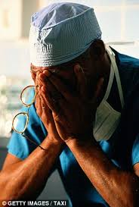
Building a Patient Safety Culture
Individual Blame or Fear Thereof:
Can lead to less-than-transparent reporting of information needed to discover the true root and contributing causes of an adverse event.
Can negatively impact general occurrence reporting for adverse events and good catches/near misses.
Can give a false sense of confidence that the “cause” was addressed while the system vulnerability remains.
Notes:
If people become “afraid” of getting in trouble and don’t report their concerns to us, then we will never know that problems exist that need to be fixed. A Highly Reliable Organization relies upon its people to report problems so that the problems can be fixed. Maintaining this “trust” amongst our employees is vital to keep the reporting happening. In the safety world, we actually prefer to see higher volumes of safety reports. At the end of the day, we all know that safety events are happening. If our safety reporting numbers are high, this is a good sign that staff actually feel “safe” to tell us about them.

Slide 6
Ochsner's Commitment to Building a Safety Culture
We acknowledge the high-risk nature of our activities and strive to achieve consistently safe operations.
We embrace a blame-free environment where individuals are able to report errors or good catches without fear of reprimand or punishment.
We encourage collaboration across ranks and disciplines to see solutions to patient safety problems.
We commit needed resources to address safety concerns.

Slide 7
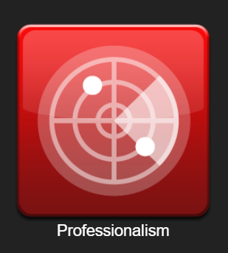
Ochsner programs that support a Safe and Just Culture
C.O.P.E.
Connecting with Our Peers through Empathy ​is a peer support program designed to provide a form of emotional first aid to health care providers involved in stressful or challenging patient events.
The program is strictly voluntary, highly confidential, and is available to all Ochsner care providers experiencing distress following an adverse patient event.
Peer Professionalism Program
Program to facilitate informal “cup of coffee” conversations between peer providers to bring awareness to a minor breach in professional behavior
Trained peers deliver message that a behavior was observed in a respectful and non-judgmental way
Professionalism Form
within SOS
Notes:
Professionalism events are addressed in accordance with our Core Values and related policies. Specific details of the outcome are not available, but rest assured that these events are seriously considered and appropriately addressed.

Slide 8
Introducing S.O.S.
Your Role
Training
Safety Culture
Notes:
All Ochsner employees, including physicians, are expected to report occurrences in an effort to improve Safety throughout the organization. Each one of us has a “mission critical” role in improving safety, regardless of whether we have direct or indirect contact with the patients.

Slide 9
Why should I Complete an Occurrence Report?
To keep our PATIENTS and EMPLOYEES safe
Occurrence reports help to identify potential or actual problems/barriers related to processes and services so that they can be resolved
The information is used to help determine causes of an event or good catch in order to prevent future events
Occurrence reports identify trends and patterns so that action can be taken to prevent similar occurrences
Notes:
If frontline employees don’t report their concerns, leaders will never know about them to be able to fix them

Slide 10
Who Should Complete an Occurrence Report?
Everyone! Anyone with an Ochsner email, even an Ochsner vendor email, can report an occurrence
Person who is directly involved in the event/good catch
Person who witnesses the event/good catch
Notes:
Anyone with an Ochsner email can report an occurrence and the more perspectives we receive the better we are able to understand and resolve the issues our providers and patients face

Slide 11
Occurrence Reports Are:
Used to identify trends
Peer review protected, confidential and privileged per LA RS 13:3715.3
Objective and factual representation of the event
Notes:
Occurrence reports are used to identify trends throughout the organization. It is important to remember that entering every occurrence that you are aware of, even it if only happened once or was a near miss, will assist in identifying trends across the organization for process improvement. One person can make a difference.
The SOS system is Peer Review protected and confidential. Outside attorneys can not obtain SOS reports for use in litigation.
Occurrence reports should be factual, they are not used to place blame. They are used to identify issues occurring throughout the organization in order to develop Performance Improvement projects and improve Safety. For example, the patient handoff process was revised in response to a trend in patient falls.
Recognizing that we learn from our mistakes and our successes, the data they provide is a valuable resource to evaluate and prevent occurrences, and enhance patient, visitor, and employee safety.

Slide 12
Occurrence Reports Are:
Not Punitive
Not to be documented in the medical record
Not to be printed, copied, or distributed
Notes:
Occurrence reports are not to be used in a punitive manner. Most often, occurrences happen not because of a person, but rather because of a process. This non-punitive culture is supported through our Just Culture policy, which can be found on Ochweb.
Occurrence reports entered into SOS are not part of a patient’s medical record. Although incidents leading to an occurrence report and any actions taken as a result of that incident should be documented, there is no need to document that an occurrence report was completed.
Also, you should never print, copy, or distribute an occurrence report. Occurrence reports are not released to patients, visitors, or employees, they are for internal use only. Any requests for a copy of an occurrence report should be directed to the Performance Improvement Department for handling.

Slide 13
What to Report
Reportable events are broadly defined as any defect, error, medical accident, near miss, significant procedure variance, or unsafe condition that did or could result in a patient, visitor or employee injury, hazardous condition, or risk in the environment of care throughout Ochsner Health.
Notes:
The purpose of the SOS system is to report any defect, error, medical accident, near miss, or significant procedure variance that could result in a patient, visitor or employee injury, hazardous condition, or risk in the environment of care throughout Ochsner Health.
If there is a concern for the safety of yourself or your patient an SOS report should be filed.
The reports are used to identify trends, implement performance improvement measures and action plans to prevent recurrence.

Slide 14
Examples of Occurrences
A fall by a patient
Medication error & near misses, or adverse drug events
Specimen related issues, or pressure injuries
Equipment malfunction, hazardous conditions, or any risk in the environment of care
An unexpected complication or death
Communication or system issues which effect delivery of care
Employee/affiliate injury, contact, or professionalism incidents
Any medical defect or error
Unsafe Condition Example- The location of the television in the provider conference room isn’t ideal. The television cord crosses part of the room, making it possible for someone to trip over it.
Notes:
Occurrences should be reported in instances such as: Falls/injuries, medication errors/near misses/adverse drug events, pressure ulcers/skin integrity issues, lab/specimen related issues, surgery/invasive procedure issues, unexpected complications, employee incidents, safety incidents, blood/body fluid exposure, equipment malfunction, or any other unusual events that are observed.

Slide 15
S.O.S. specific examples
Occurrence-We performed a radiology exam on the wrong patient because we didn’t use 2-patient identifiers.
Delay of Care Occurrence- An immune-compromised patient had blood cultures turn positive over the weekend. The lab was unable to get in touch with the correct provider to notify them of the results. This resulted in the patient going an entire weekend without the initiation of antibiotics.
Medication Error Occurrence- We administered the wrong drug to the patient. We didn’t perform barcode scanning of the medication.

Slide 16
Sentinel Events
Unexpected occurrences involving death or serious physical or psychological injury, or the risk thereof.
“or the risk thereof” includes major process variation for which a recurrence would carry a significant chance of a serious adverse outcome.
Must be immediately reported to the Performance Improvement Department
Must be immediately entered into the S.O.S. system
Notes:
A Sentinel Event is defined as an unexpected occurrence involving death or serious physical or psychological injury, or the risk thereof. The phrase “or the risk thereof” includes major process variation for which a recurrence would carry a significant chance of a serious adverse outcome.
Due to the nature of these incidents, it is important that you notify your direct supervisor or the PI Department immediately, and enter an SOS report immediately after the event. This will allow us to begin the investigation process and handle any further patient needs as soon as possible.

Slide 17
Examples of Sentinel Events
Serious injury specifically includes loss of limb or function
A Patient death, paralysis, coma, or other major loss of function associated with a medication or blood transfusion related event
A patient fall that results in death, permanent loss of function, or additional surgery
Any procedure performed on the wrong patient, wrong body part or unintended retention of a foreign object
Abduction of any patient receiving care, treatment or services
Discharge of an infant to the wrong family
Rape or sexual assault of any patient
Abduction of any patient receiving care, treatment, and services
Notes:
Some examples of Sentinel Events are listed here. Please click next once you have read through this list for the additional examples on the next slide.

Slide 18
Examples of Sentinel Events
Unintended retention of a foreign object in a patient after surgery or other procedure
Severe neonatal hyperbilirubinemia (bilirubin >30 milligrams/deciliter)
Crime or allegation of crime against a patient visitor, or employee such as assault, battery, rape, sexual molestation
Any patient death, paralysis, coma, or other major permanent loss of function associated with a medication error
Any delivery of radiotherapy to the wrong body region or >25% above the planned radiotherapy dose
Any elopement, that is an unauthorized departure, of a patient from an around-the-clock setting resulting in a temporally related death
Any intrapartum (related to the birth process) maternal death
Assault, homicide, or other crime resulting in patient death or major permanent loss of function
Notes:
When a Sentinel Event occurs, the Performance Improvement Department will conduct a Root Cause Analysis (RCA) in order to identify what the actual root cause was that allowed the incident to occur. An RCA team, consisting of member(s) of the PI Department, as well as subject matter experts, etc… will convene to review the incident, look at processes, and determine what action plans need to be implemented in order to prevent a recurrence of the incident.

Slide 19
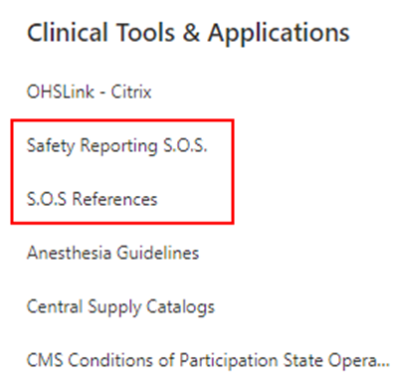
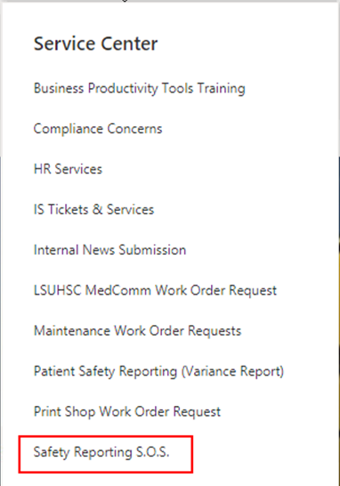
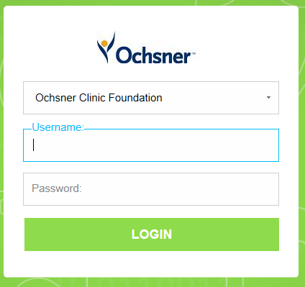
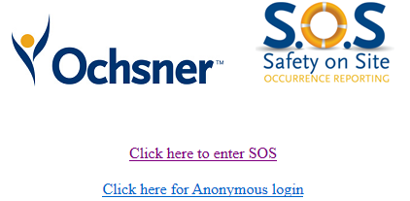
Where to Find S.O.S.
Can be found on Ochweb under the Service Center, My Work, or Job Resources
Shortcut to SOS has also been created for clinical and non-clinical desktops for all Ochsner-owned computers, including workstations and kiosks
Log in using your Ochsner active directory credentials- there is an anonymous login option
1.
2.
3.

Slide 20
Real changes implemented as a result of a reported event
Pt with one kidney and resultant CKD had order for CT of the abdomen/pelvis WITHOUT contrast. Order was changed to a CT with and without contrast by radiologist.
Actions:
Change in Epic to make the order specific questionnaire question “May the radiologist change the order per protocol to meet the clinical need of the patient?” present in all imaging test orders with a hard stop.
Ordering physicians will be required to answer either “Yes” or “No” to the question as the answer options will no longer default to “Yes”
Reported by a Provider

Slide 21
Real changes implemented as a result of a reported event
Newborn had LP that was sent to system lab. System lab cancelled the test because there was peripheral blood in the CSF; appropriate notification of the cancelled test never happened and the pt was d/c home without CSF results
Actions:
Education to lab regarding awareness of notification protocols and specimen retainment practice.
System fix for cancellation reasons to go into MD inbox with education to MD’s on reviewing emails for reasons
Daily outside lab cancellation report reviewed by lab director and ensure proper follow up done.
Nursing will address inpatient notification. Outpatient will be sent to MD inbox.

Slide 22
Real actions taken as a result of a reported Good Catch
OB/GYN patient transferred to Ochsner from an outside facility. Patient’s external blood type result was manually entered incorrectly into Epic. The error was caught before any blood was administered to the patient.
Action:
System workgroup focused on implementation of a double check workflow

Slide 23
S.O.S. Occurrence Reporting
If you have any questions or comments:
Contact the SOS Help Desk at soshelpdesk@ochsner.org
Or contact the Performance Improvement/Quality Department at your facility
Notes:
In closing, we want to stress, once again, that every individual in our System plays an important role in improving safety for our patients, visitors and employees. Thank you for your commitment to helping to create a culture which values safety and system process improvement by reporting of safety events.

Slide 24
Appendix

Slide 25
Getting started with S.O.S.
Role
Training
Safety Culture
Notes:
Now, let’s walk through the process of reporting an occurrence through S.O.S

Slide 26
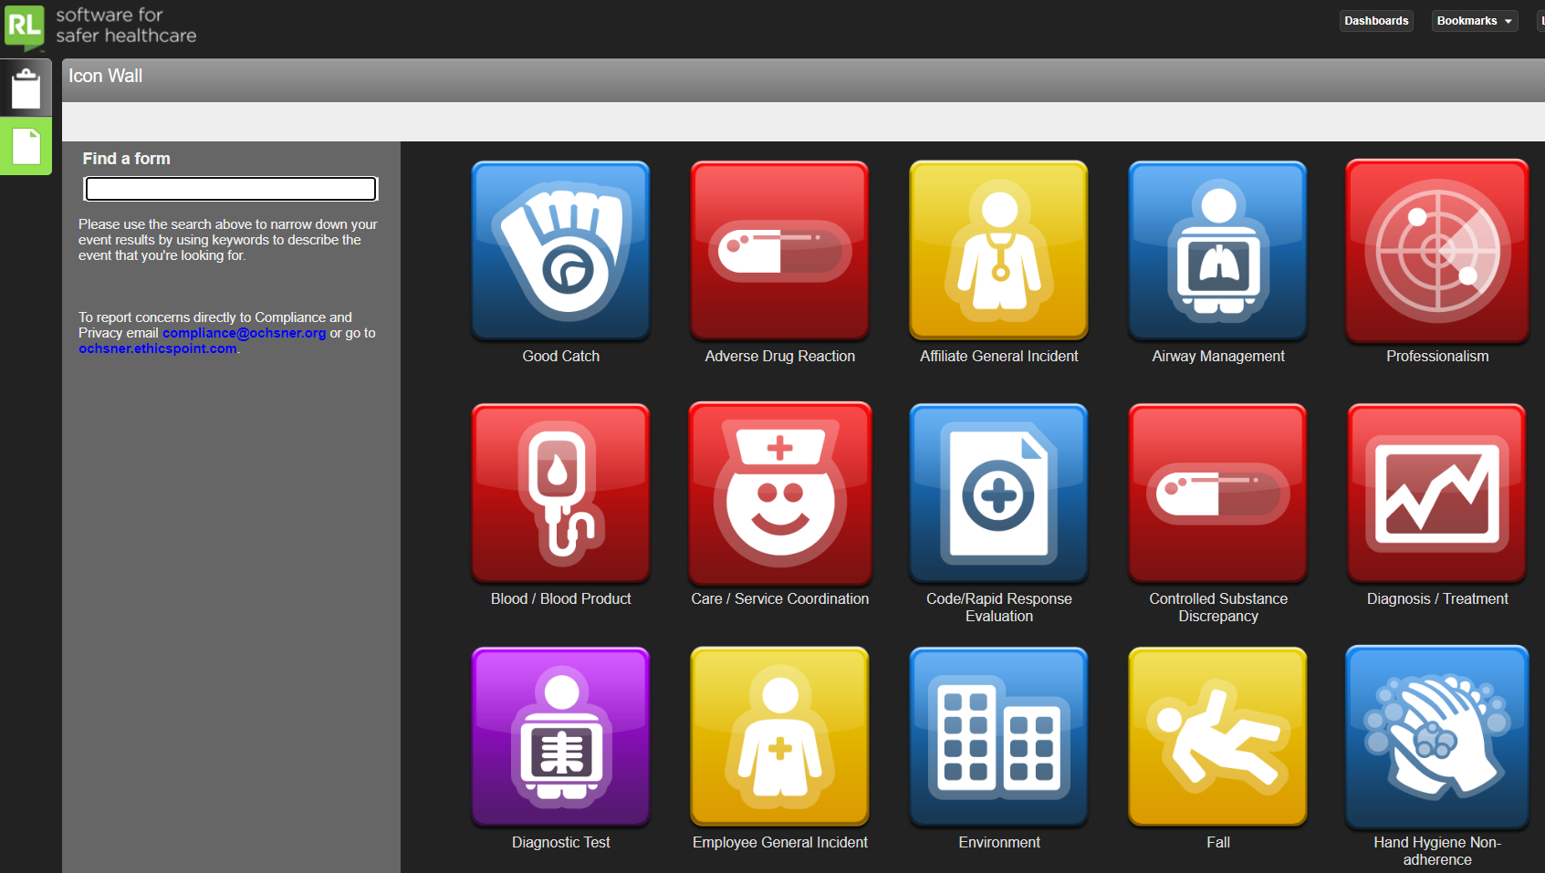
Creating an Occurrence Report
After logging in, you can select the type of occurrence you would like to report by choosing the corresponding icon.
Select the Report and occurrence button
If you are returning to complete an incomplete occurrence select the “Open incomplete files option
Notes:
After logging into SOS you can select the type of occurrence you would like to submit.

Slide 27
Creating an Occurrence Report
You can use the Find a Form search box to search for a general occurrence type or you can scroll through the icon wall to find the type. Click on the icon to begin the submission form.
Notes:
You can use the Find a Form search box to search for a form type or you can scroll through the icon wall to find the form type.

Slide 28
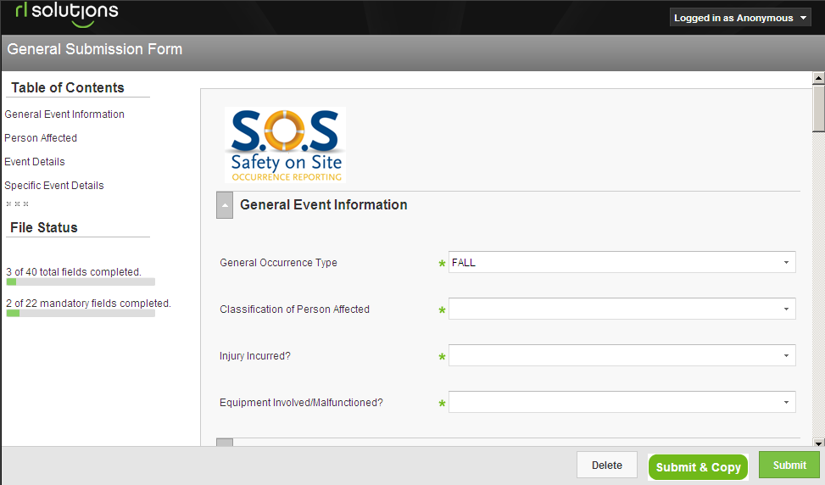
Creating an Occurrence Report
When creating a new occurrence report the first step will be to complete the general occurrence information.
Click the drop down list to select an option
A status tracker on the left side shows how many total and mandatory fields are left
Green asterisks indicate required fields
Notes:
When creating a new occurrence report the first step will be to complete the general occurrence information.
This includes:
The general occurrence type, which will be pre-populated based on the icon that you clicked from the icon wall
The classification of person affected, for example: in-patient, out-patient or visitor
Whether an injury incurred as a result of the incident
Whether any equipment was involved in the incident
Selections for each of these can be made from the drop down menus. All fields that have green asterisks to the left are required. A status tracker on the left side shows how many total and mandatory fields are left

Slide 29
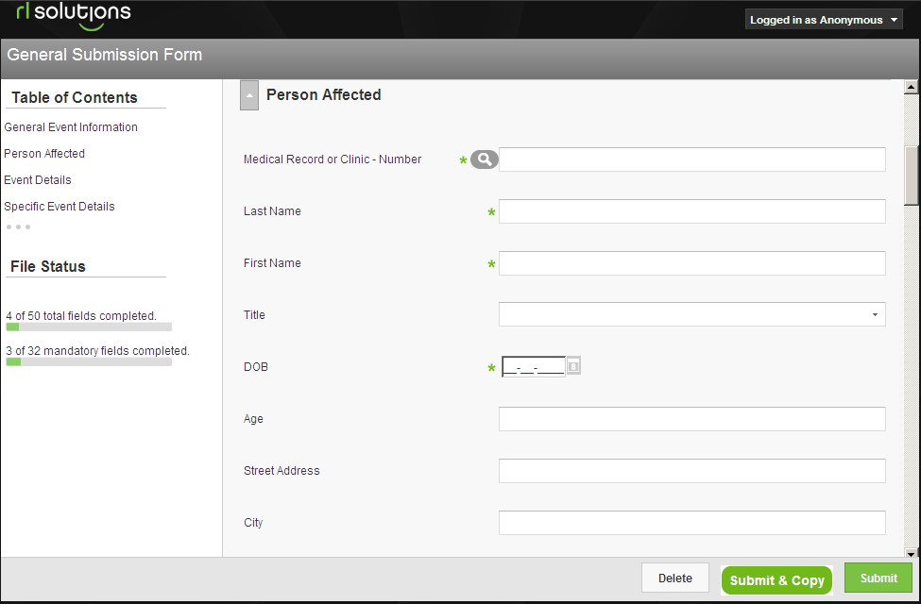
Creating an Occurrence Report
The next step is entering information regarding the person affected by the incident that you are reporting.
… or you can search for the person in the patient look-up which will automatically populate their demographic information.
You can enter the demographics information manually…
Green asterisks indicate required fields
Notes:
The next step is entering information regarding the person affected by the incident that you are reporting.
Demographic information can be entered manually or if the person involved is a patient you can use the search tool. Patients can be searched using their clinic or medical record number or their last name. When a patient is found in the database their demographic information will be filled in automatically.
The required information will be different depending on the category of person affected, for example if the incident involves an in-patient, the name of the patient’s physician will be required. Like the patient information, physician information can be entered manually or by using the physician search tool.

Slide 30
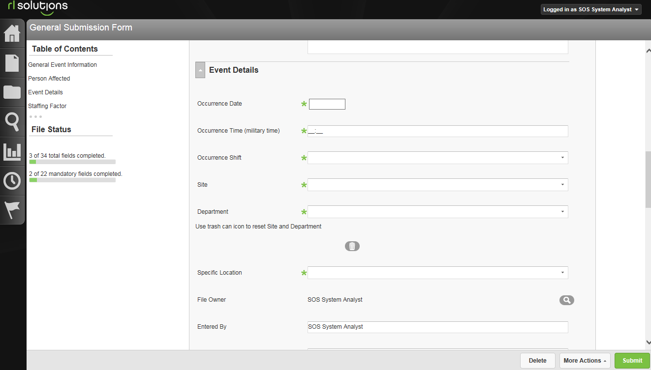
Creating an Occurrence Report
Next you will enter the event details. This includes the date and time of the event as well as the site and department of where the event happened.
Click the drop down arrow to select options
Green asterisks indicate required fields
Notes:
Next you will enter the event details. This includes the date and time of the event as well as the site, department and specific location where the event happened.
The required information will be different depending on the category of person affected and the occurrence type.

Slide 31
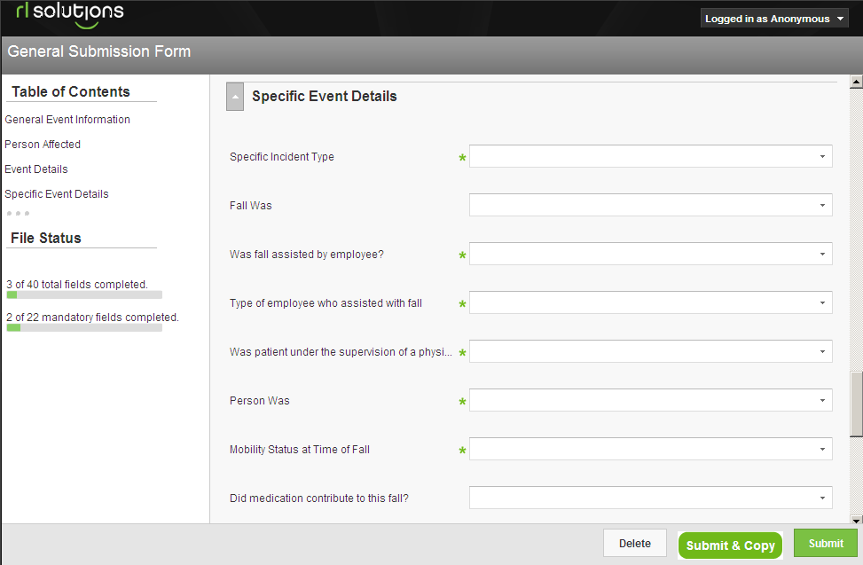
Creating an Occurrence Report
Next, fill in specific incident details and enter a brief description in “Just the facts.” Fields vary based on the type of occurrence you are entering.
Green asterisks indicate required fields
Notes:
You then be asked to complete specific occurrence details. This includes:
The specific incident type, which is based on the general occurrence type. For example for a fall, the specific incident type will be the type of fall that occurred like a fall from a bed or a fall while walking, etc.
Any factors that may have contributed to the occurrence
Reported incident severity
A brief description of the occurence in “just the facts”

Slide 32
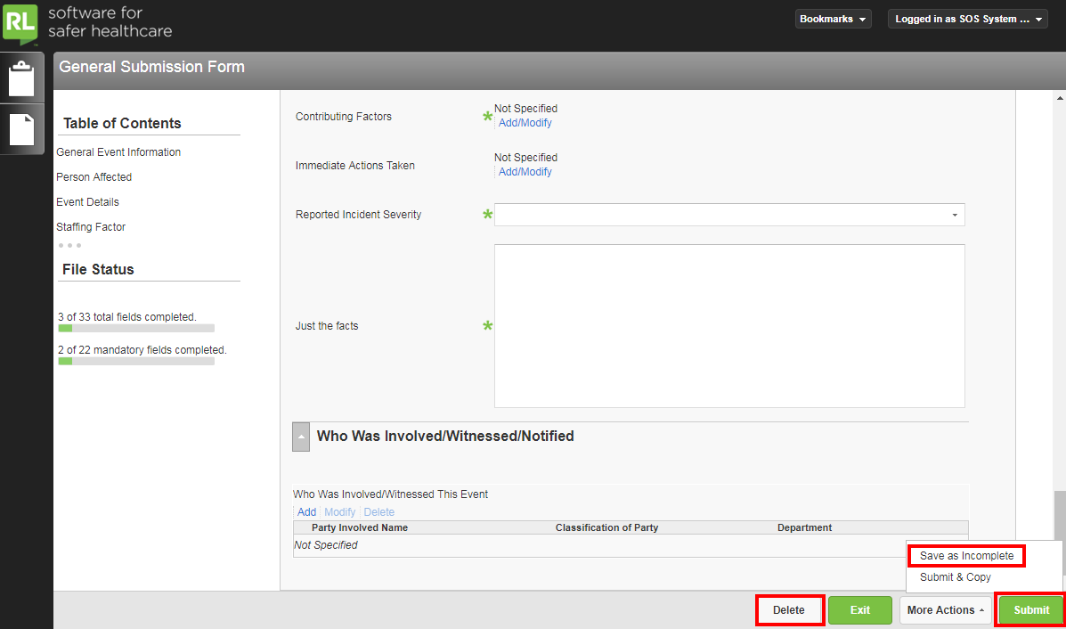
Summiting an Occurrence Report
Delete and Save As Incomplete are available at any point during submission
Click here to Submit
Notes:
To submit the occurrence report, click on the “Submit Occurrence” button. SOS will not allow submission of a report if any of the required fields are not completed.
At any point during the occurrence reporting process you may choose to delete the occurrence or save the occurrence as incomplete which can be found under More Actions. If you have logged in using your windows ID and password you can return at a later time to complete an incomplete occurrence.

Slide 33
Completing an Occurrence Report
If you are returning to complete an occurrence report that was previously started or to find out what happened to your SOS submission, click on the clipboard button in the upper left corner to select your Info Center.
Notes:
If you are returning to complete an occurrence report that was previously started, click on the home button in the upper left corner to select your info center.

Slide 34
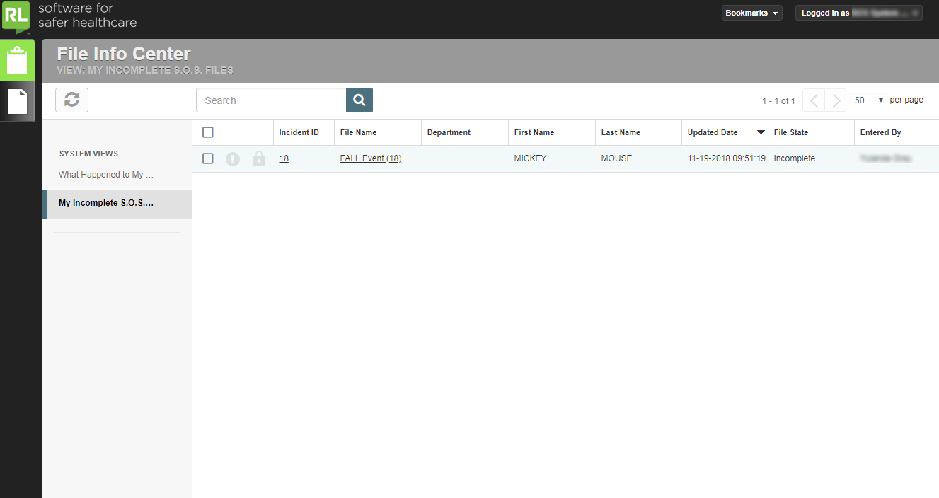
Completing an Occurrence Report
From your Info Center, you can complete previously started files and view what happened to files you have submitted once they have been closed.
To view your incomplete files, click on the My Incomplete S.O.S. Files view.
To open an incomplete file to submit it, click on the Incident ID or File Name.
Notes:
From the Info Center you can add a follow up to an incident you have already submitted and view your incomplete files

Slide 35
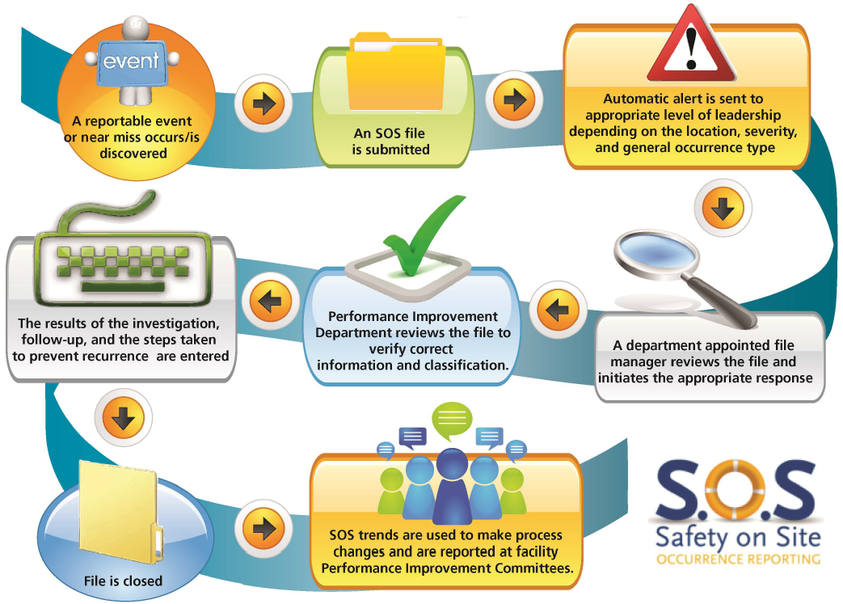
Life Cycle of An SOS Occurrence

Slide 36
What happens to my report?
Occurrence reports are reviewed at the department level, as well as by the Performance Improvement Department, in order to identify trends and institute performance improvement measures and action plans as appropriate.
Department Directors and Managers will have summary reports of occurrences for specific locations, and can share this data with staff.
Notes:
What happens to your report?
Each Department Director or Manager receives all occurrences for their area, and is required to review and investigate as appropriate. They also have the ability to pull trending reports for their departments.
The Performance Improvement Department reviews all occurrences, identifies trends for performance improvement projects, and reports up through various committees.

Slide 37
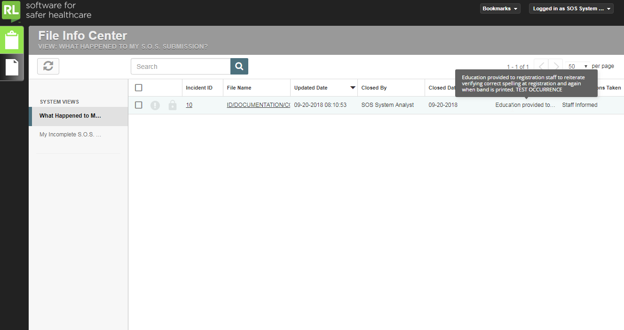
Checking what happens to my report.
You can view the outcome of an occurrence you submitted (excluding Behavior related occurrences) from your Info Center.
The investigation and action plans can be found here by hovering over the Outcome Notes column which will bring up the full text.
Once your file has been closed you can find it in the What Happened to My Submission? view. You will be able to view the date the event was closed, who closed the file, and the results of the investigation and what actions were put in place to prevent recurrence of that event.
Notes:
From the Info Center you can add a follow up to an incident you have already submitted and view your incomplete files
Professionalism events are addressed in accordance with our Core Values and related policies. Specific details of the outcome are not available, but rest assured that these events are seriously considered and appropriately addressed.

